Slide 1
Identify Diversely Owned/Led Business
Monsoon Masters
May 2022

Slide 2
Solution Outline
Problem Description
Solution Approach
HLD(MVP)
Features and Benefits
User Stories
Current Sequence Flow
Vision for Future
Appendix

Slide 3
Solution Approach
We have used Azure Logic Apps and Azure ML to implement the solution
Used Low/Code, No Code Approach
Most implementation done with Azure Logic Apps(serverless), that simplifies deployment
The Flow will be:
Excel Sheet Provided
→ Correlate with data from Public APIs, Social Media APIs
→ Curate and create Enriched Data
→ Store Data in Azure Cosmos DB
→ Run Azure ML on the curated data
→ Derive Required labels and update in the excel sheet

Slide 4
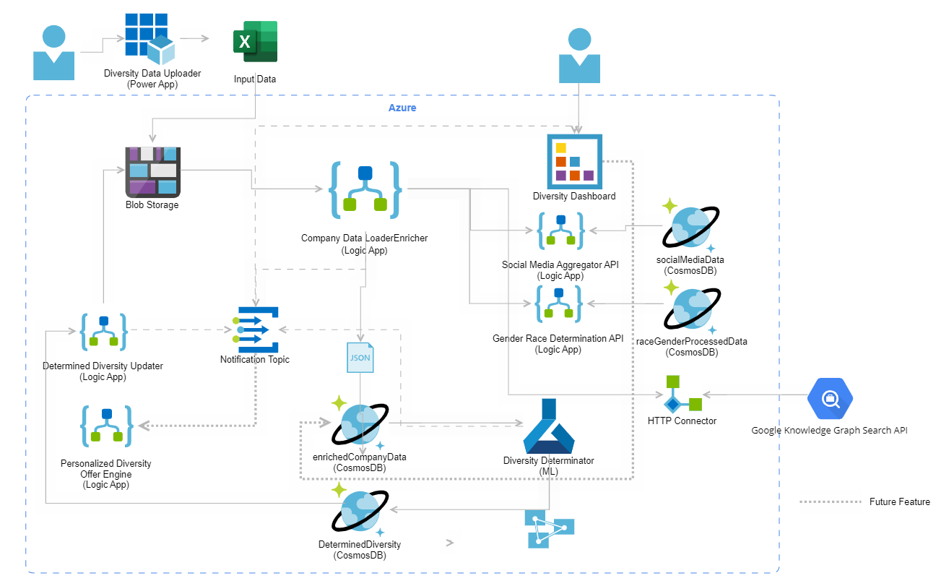
Solution Approach

Slide 5
Solution Details
Enrichment
Uses aggregated social media tags to determine LGBTQ/Differently Abled/Veteran dimensions
Uses pre-processed public data co-related with First Name/Last Name to determine Gender and Ethnicity
Uses Google Knowledge Search Graph to determine Leadership.
Diversity Determination
Machine Learning based diversity identification using enriched data.
ML model trained using self identified social media dataset.
Hybrid diversity identification, based on Rules and NLP.

Slide 6
Features and Benefits
Feature | State | Benefit
Low Code/No Code | Current | Enhanced time to market Reduced boilerplate code
Serverless Code | Current | Ease of deployment Cost optimization
Usage of Public APIs/Data | Current | Limited data scraping toil Quality of data Bias reduction
Personalized Offer Engine | Future | Targeted marketing Lead generation and conversion
Diversity Dimensions Dashboard | Future | Better visibility of metrics Deep dive into diversity factors
ML Model for diversity determination | Current | Evolving and improving determination Multidimensional prediction Bias reduction
Personalized Advertising | Future | Social media lead generation Enhanced feedback into social media aggregation process

Slide 7
User Stories
As a "Bank" I want to "Identify Diverse Led Business" so that "we become the industry leader in diversity and inclusion“
As a “DE&I Initiative Team” I want to “provide partial company reference data” so that “I can Identify Diverse Led Business”
As a “Diverse Led Business” I want to “receive friendly offers” so that “I can enhance ease of business ” and “help additional Diverse population”

Slide 8
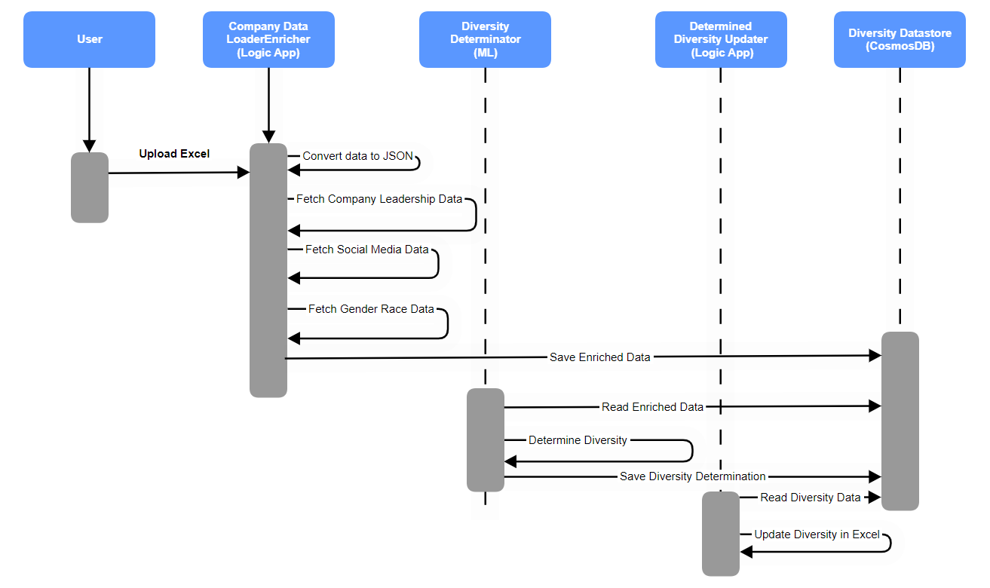
Sequence Diagram

Slide 9
Vision for future
Give a diversity score based on the number of diversity parameters and their priority category met(e.g. of priority: )
Based on diversity score, generate hyper personalized offer engine, that will create offers to be communicated to targeted diversity audience
Create awareness about offers via email campaigns, targeted ads on Social Media, educational videos on the special benefits
For existing customers, use the WF portals for messaging with special offers
Email service with templates for each diversity category

Slide 10
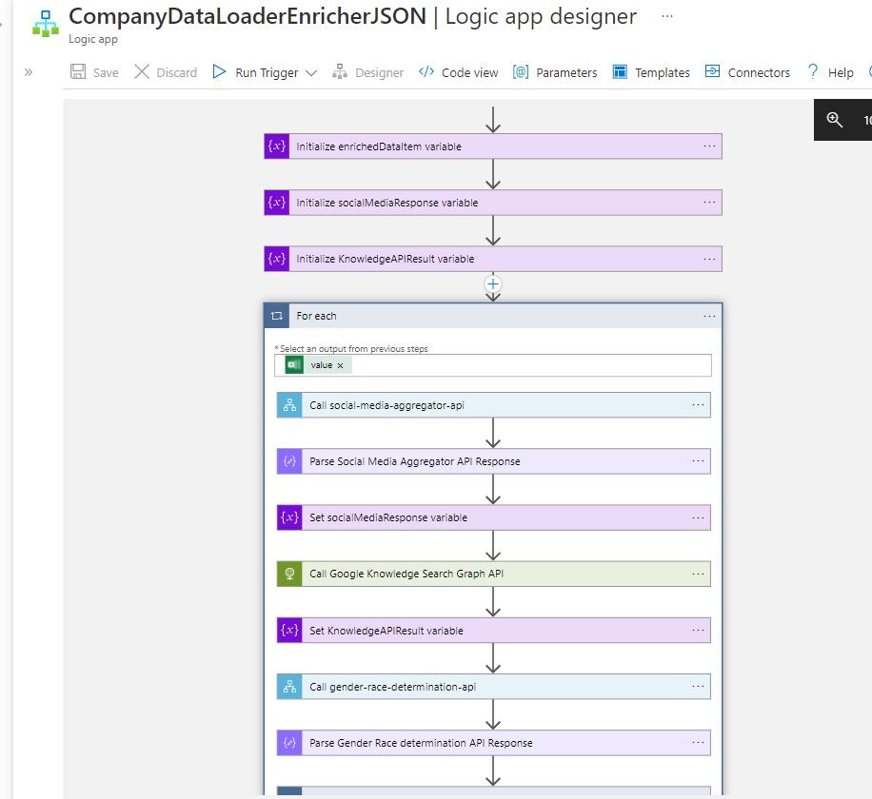

Slide 11
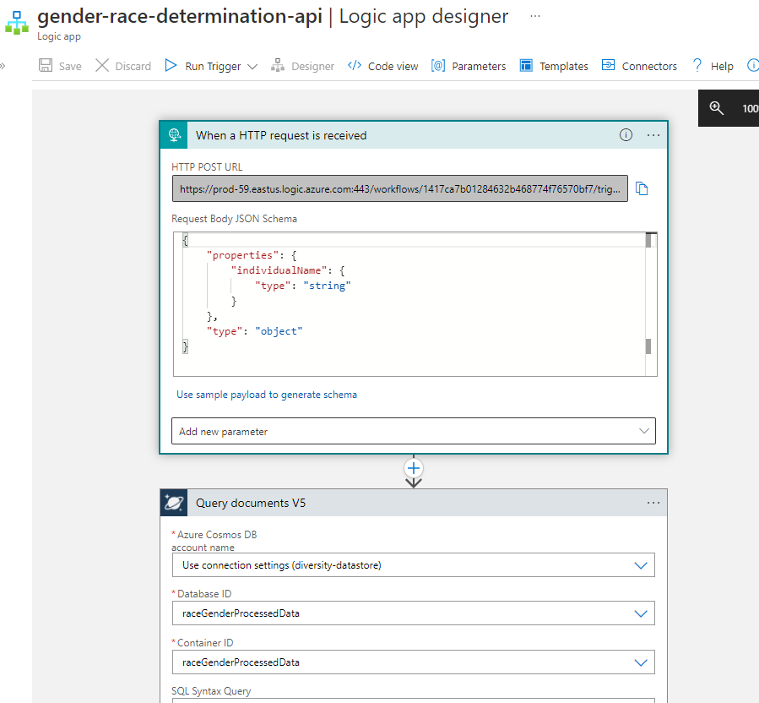

Slide 12
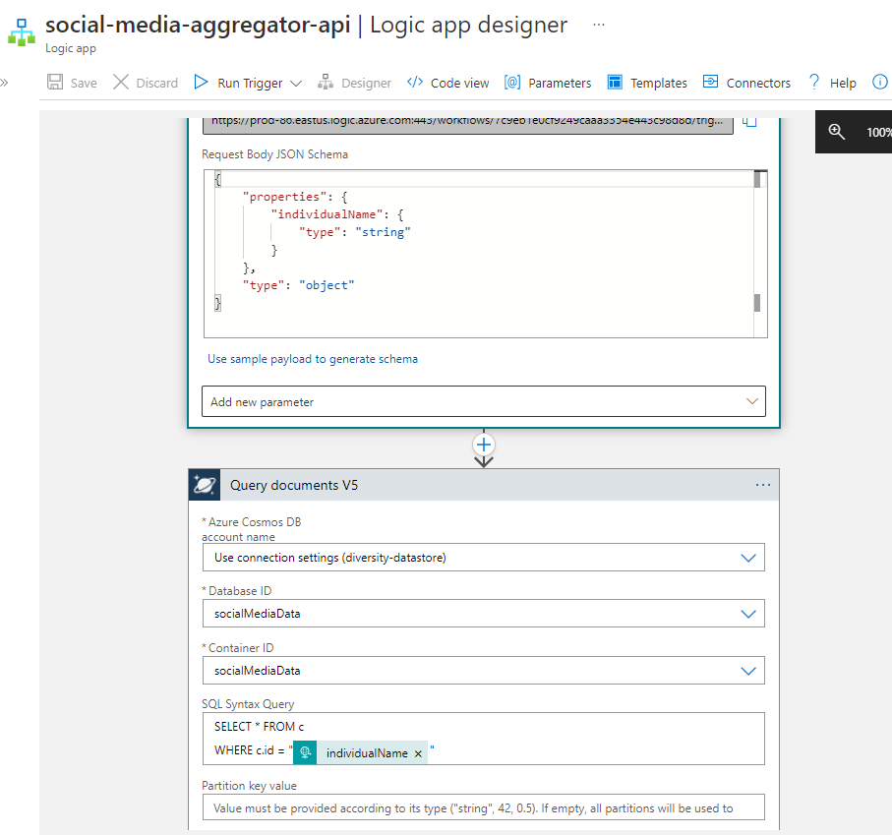

Slide 13
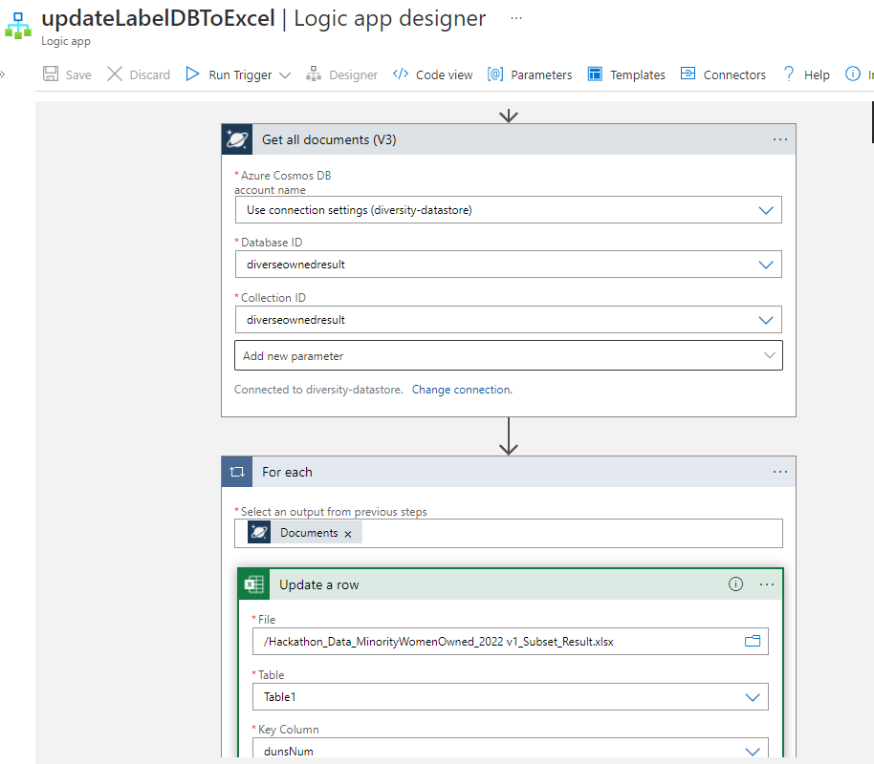

Slide 14
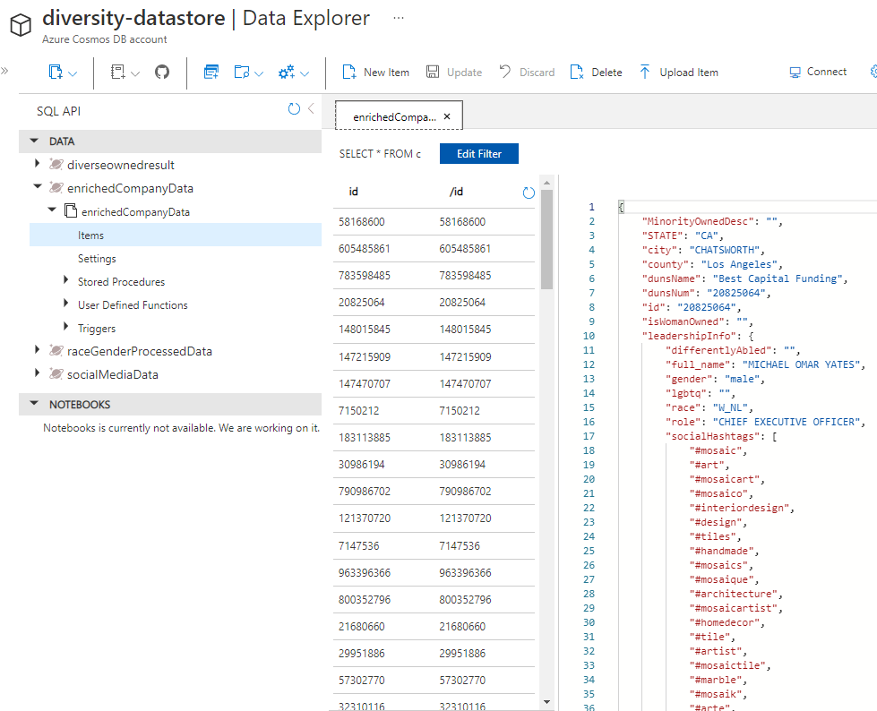

Slide 15
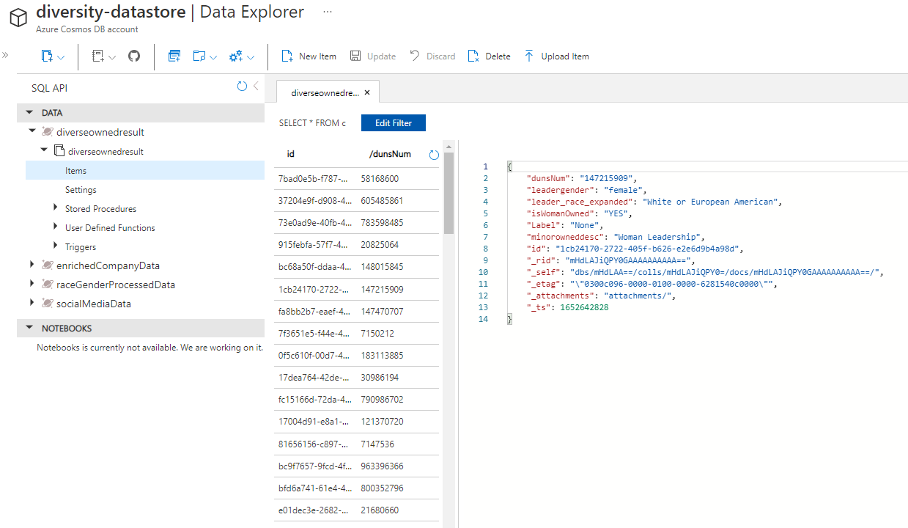

Slide 16
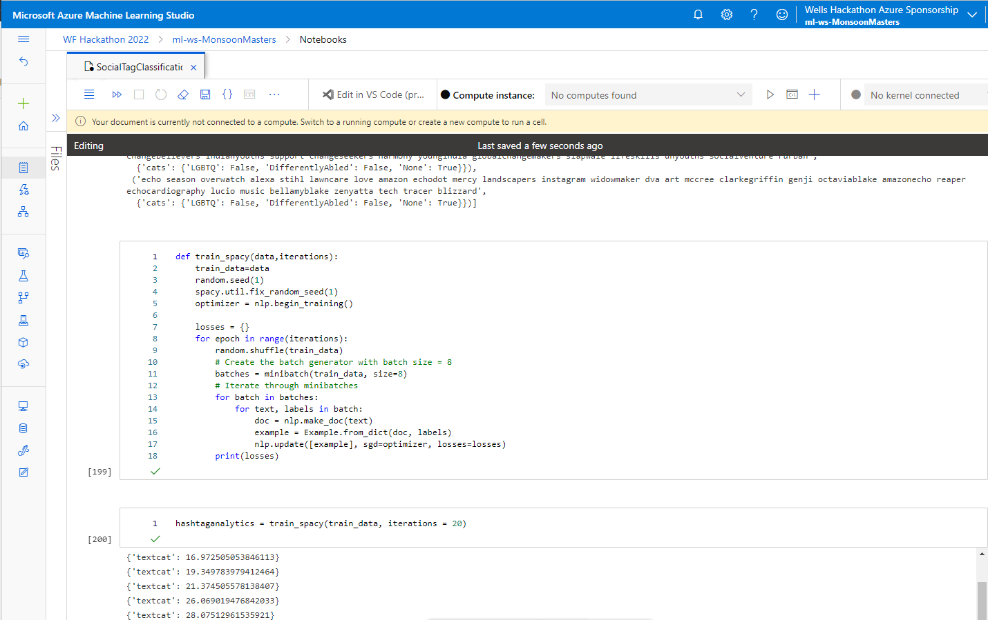

Slide 17
Appendix
Public APIs used:
Google Knowledge Graph Search API : Google Knowledge Graph Search API | Google Developers
Gender API : Gender API
Namsor API : Namsor API
GIT Repo URL : monsoonmasters2022/LeadershipDiversityIdentifier

